Slide 1
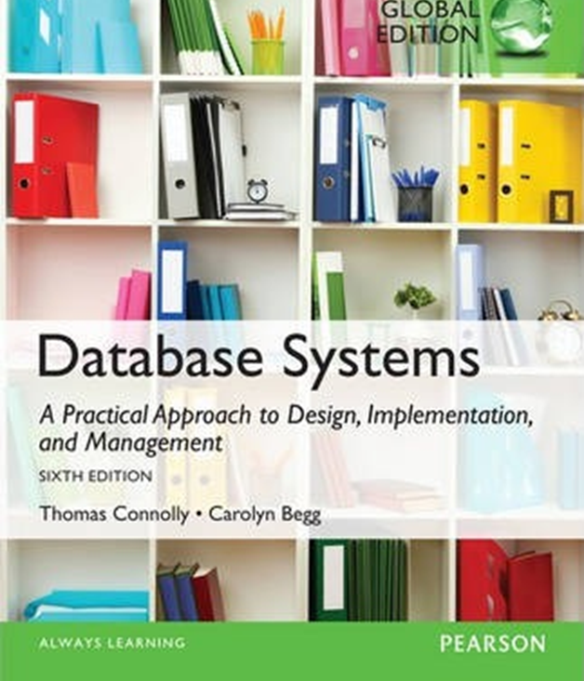
Lecture 2-1: Database Architecture
Ali Chelli
Course: Database 2 (DAT2000R)

Slide 2
Outline
Multi-user DBMS Architectures
Distributed DMBSs
Cloud Computing
Components of a DBMS

Slide 3
Multi-user DBMS Architectures

Slide 4
Multi-User D B M S Architectures
The common architectures that are used to implement multi-user database management systems:
Teleprocessing
File-Server
Client-Server

Slide 5

Teleprocessing
Teleprocessing is an old architecture with one central mainframe computer and several terminals.
All the processing is performed in the mainframe computer.
User terminals are typically “dumb”, incapable of functioning on their own.
Overload the central computer
Notes:
The terminals are cabled to the central computer (mainframe).
The terminals send messages via the communications control subsystem in the OS of the central mainframe to the application program on the mainframe, which uses the services of the DMBS.
There is now a trend towards downsizing, that is, replacing expensive mainframe computers with more cost-effective networks of personal computers that achieve the same results.
This trend has given rise to the next two architectures: file-server and client-server.

Slide 6
File-server architecture
Processing
A computer (file-server) attached to a network with the primary purpose of providing shared storage for computer files
High network traffic
Retrieving corresponding files to relations (tables) instead of the records that satisfy the query
DBMSs can be different, thus, concurrency, recovery, and integrity are difficult to maintain
Storage

Slide 7
File-server architecture
In a file-server environment, the processing is distributed between the workstations and the file-server.
The file-server holds the files required by the applications and the DBMS.
However, the applications and the DBMS run on each workstation, requesting files from the file-server when necessary.
In this way, the file-server acts simply as a shared hard disk drive.
As the file-server has no knowledge of SQL, the DBMS must request the whole tables from the file-server, rather than just the records that satisfy the query.

Slide 8
File-server Disadvantages
There is a large amount of network traffic.
A full copy of the DBMS is required on each workstation.
Concurrency, recovery, and integrity control are more complex, because there can be multiple DBMSs accessing the same files.

Slide 9
DBMS ≠ Database
A database is a collection of your data stored in a computer
A DBMS (Database Management System) is a software that manages databases

Slide 10
Advantages of a Database System
It answers queries fast
Q1: among a set of blog pages, find those pages written by Steven Sinofsky after 2011
Q2: among a set of employers, increase the salary by 20% for those who have worked longer than 4 years
Queries (from multiple users) can execute concurrently without affecting each other
It recovers from crash
No corrupt data after restart
Modifications are logged

Slide 11
Traditional Two-Tier Client-Server (1 of 3)
Client (tier 1) manages user interface and runs applications.
Server (tier 2) holds database and D B M S.
Advantages include:
wider access to existing databases;
increased performance;
possible reduction in hardware costs;
reduction in communication costs;
increased consistency.
Notes:
It enables wider access to existing databases.
Increased performance: If the clients and server reside on different computers, then different CPUs can be processing applications in parallel. It should also be easier to tune the server machine if its only task is to perform database processing.
Hardware costs may be reduced: It is only the server that requires storage and processing power sufficient to store and manage the database.
Communication costs are reduced: Applications carry out part of the operations on the client and send only requests for database access across the network, resulting in less data being sent across the network.
Increased consistency: The server can handle integrity checks, so that constraints need to be defined and validated only in the one place, rather than having each application program perform its own checking.

Slide 12
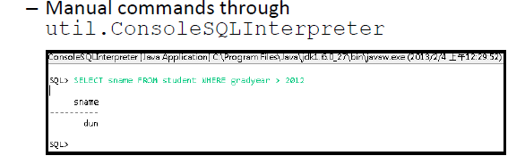
Two-tier Client-server architecture:
User interface
Business and data application logic
Consists of client process that requests resources and a server that provides resources.
Example 1:
Transaction logic
Database
Example 2:
Embedded mode:
–Through the native query interface

Slide 13
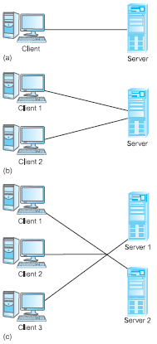
Alternative Client-Server Topologies
Single client, single server;
multiple clients, single server;
multiple clients, multiple servers.

Slide 14

Summary of Client-Server Functions
CLIENT | SERVER
Manages the user interface | Accepts and processes database requests from clients
Accepts and checks syntax of user input | Checks authorization
Processes application logic | Ensures integrity constraints not violated
Generates database requests and transmits to server | Performs query/update processing and transmits response to client
Passes response back to user | Maintains system catalog Provides concurrent database access Provides recovery control
Increased performance
Reduced communication costs
Increased consistency

Slide 15

Three-tier Client-server architecture
User interface
Designed to solve enterprise scalability challenge.
Shifting from ‘fat’ client to ‘thin’ client.
The three tiers are connected through LAN or WAN.
One application server serves multiple clients.
Business logic
Data processing logic
Thin client requires less expensive hardware
Centralized application maintenance
Modularity allows modifying or replacing one tier without affecting the others
Load balancing by separating business logic from database functions
Data validation
Database access
Notes:
The need for enterprise scalability challenged the traditional two-tier client–server model.
The Three-tier client–server architecture was designed to solve enterprise scalability challenge
In two-tiers architecture, the client side presented two problems preventing true scalability:
‘Fat’ client, requiring considerable resources on client’s computer to run effectively.
Significant client-side administration overhead which is shifted to the application server in three-tier architecture.

Slide 16
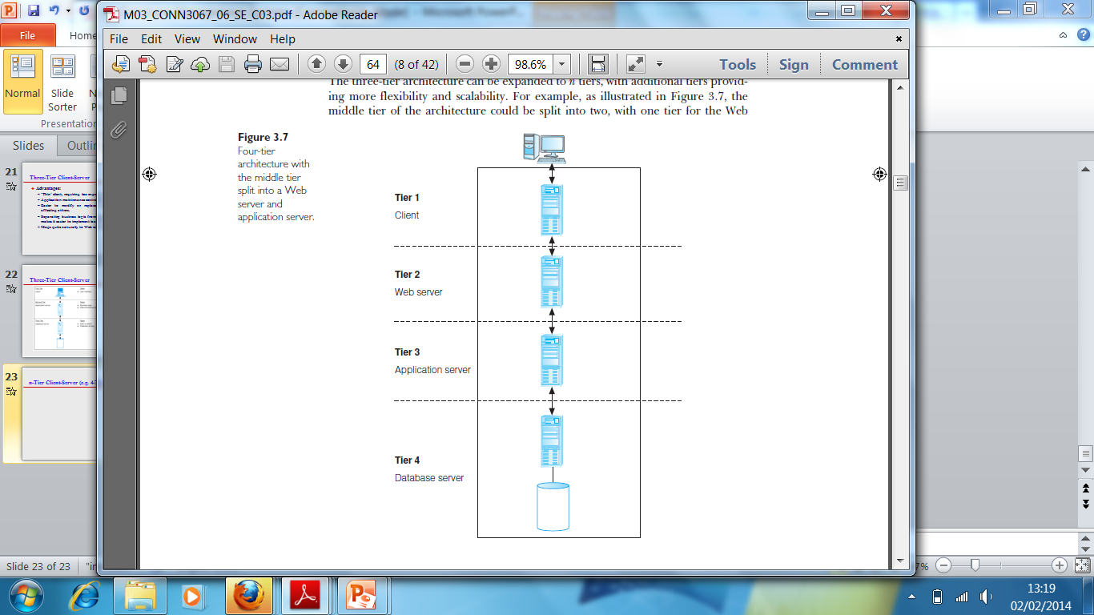
n-Tier Client-Server (e.g. 4-Tier)
The three-tier architecture can be expanded to n tiers, with additional tiers providing more flexibility and scalability.
Applications servers host A P I to expose business logic and business processes for use by other applications.

Slide 17
Middleware
Middleware is a generic term used to describe software that mediates with other software and allows for communication between disparate applications in a heterogeneous system.
The need for middleware arises when distributed systems become too complex to manage efficiently without a common interface.

Slide 18
Distributed DBMS

Slide 19
Distributed DBMSs
Decentralized approach in organizational structure: many companies nowadays are:
Logically distributed into divisions, departments, and projects.
Physically distributed into offices, plants, and factories, where each unit maintains its own operational data.
Then it is natural to have distributed DBMS that reflects such organizational structure and make data in all units accessible in a shareable and efficient manner.

Slide 20
Distributed D B M S s (1 of 2)
A distributed database is a logically interrelated collection of shared data (and a description of this data), physically distributed over a computer network.
A distributed D B M S is the software system that permits the management of the distributed database and makes the distribution transparent to users.

Slide 21
Distributed D B M S s (2 of 2)
A distributed D B M S consists of a single logical database split into a number of fragments.
Each fragment is stored on one or more computers (replicas) under the control of a separate D B M S, with the computers connected by a network.
Each site is capable of independently processing user requests that require access to local data (that is, each site has some degree of local autonomy) and is also capable of processing data stored on other computers in the network.

Slide 22
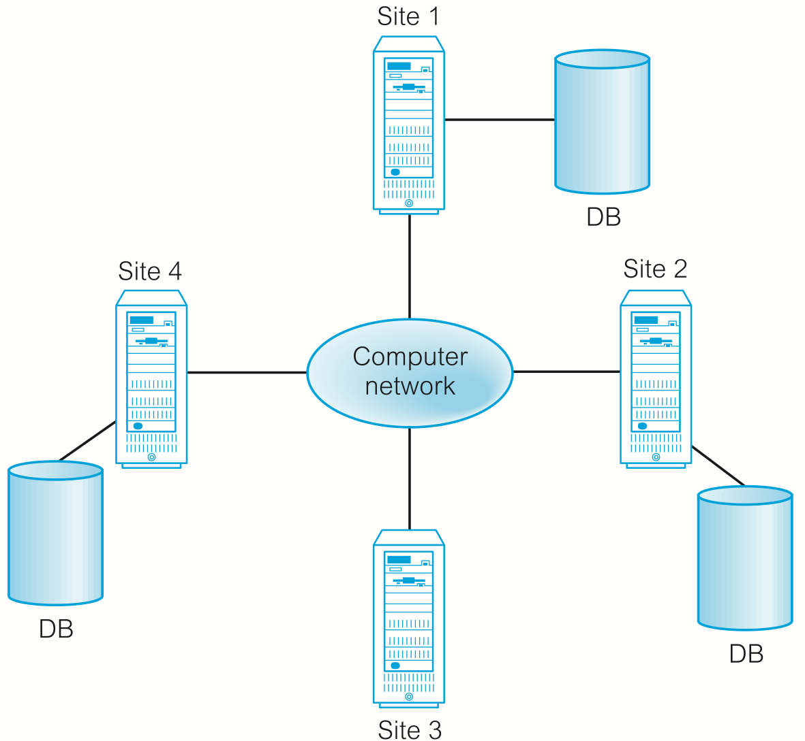
Distributed DBMSs
Users access the distributed database via applications, which are classified as those that do not require data from other sites (local applications) and those that do require data from other sites (global applications). A DDBMS is required to have at least one global application.
DBMS
Local applications
Global application(s)
Replica
DBMS
Local applications
Global application(s)
DBMS
Local applications
Global application(s)
DBMS
Local applications
Global application(s)
Replica
Replica
It is not necessary for every site to have its own local database

Slide 23
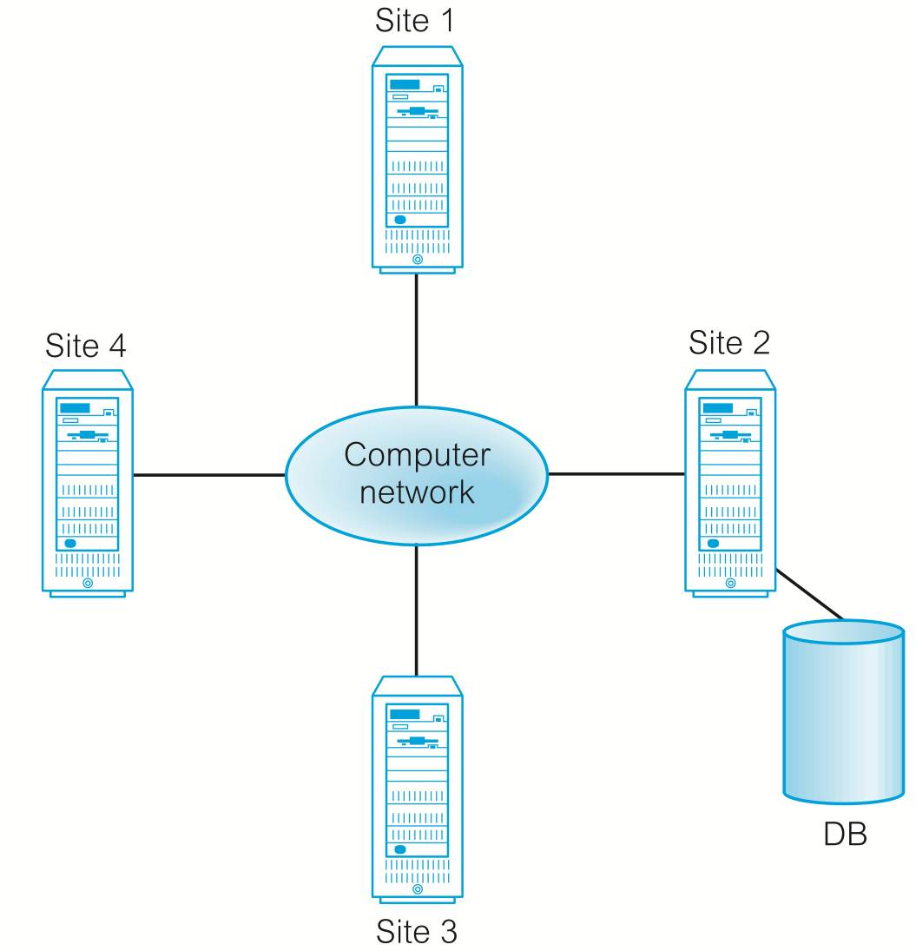
Distributed Processing
It is important to distinguish between a distributed DBMS and distributed processing
Distributed processing:
The data is centralized
The users access the data over the network
We do not consider this to be a distributed DBMS, but we consider it a distributed processing.
distributed processing topology

Slide 24
Cloud Computing

Slide 25
Cloud Computing (1 of 2)
The National Institute of Standards and Technology (NIST) provided this definition for cloud computing:
A model for enabling ubiquitous, convenient, on-demand network access to a shared pool of configurable computing resources (e.g. networks, servers, storage, applications, and services) that can be rapidly provisioned and released with minimal management effort or service provider interaction.
Mell, P., & Grance, T. (2011). The NIST Definition of Cloud Computing ( Draft ) Recommendations of the National Institute of Standards and Technology. Retrieved from https://nvlpubs.nist.gov/nistpubs/Legacy/SP/nistspecialpublication800-145.pdf
Notes:
Mell, P., & Grance, T. (2011). The NIST Definition of Cloud Computing ( Draft ) Recommendations of the National Institute of Standards and Technology.
Retrieved from: https://nvlpubs.nist.gov/nistpubs/Legacy/SP/nistspecialpublication800-145.pdf

Slide 26
Cloud computing
Four important points about cloud computing:
Characteristics
Service models
Deployment models
Benefits and risks

Slide 27
Cloud Computing – Key Characteristics (1 of 3)
On-demand self-service
Consumers can obtain, configure and deploy cloud services without help from provider.
Broad network access
Accessible from anywhere, from any standardized platform (e.g. desktop computers, laptops, mobile devices).

Slide 28
Cloud Computing – Key Characteristics (2 of 3)
Resource pooling
Provider’s computing resources are pooled to serve multiple consumers, with different physical and virtual resources dynamically assigned and reassigned according to consumer demand.
Examples of resources include storage, processing, memory, and network bandwidth.

Slide 29
Cloud Computing – Key Characteristics (3 of 3)
Rapid elasticity
Provider’s capacity caters for customer’s spikes in demand and reduces risk of outages and service interruptions. Capacity can be automated to scale rapidly based on demand.
Measured service
Provider uses a metering capability to measure usage of service (e.g. storage, processing, bandwidth, and active user accounts).

Slide 30
Cloud Computing – Service Models (1 of 3)
Software as a Service (S a a S):
Software and data hosted on cloud. Accessed through using thin client interface (e.g. web browser). Consumer may be offered limited user specific application configuration settings.
Examples include Salesforce.com sales management applications, NetSuite’s integrated business management software, Google’s Gmail and Cornerstone OnDemand.

Slide 31
Cloud Computing – Service Models (2 of 3)
Platform as a Service (P a a S)
Allows creation of web applications without buying/maintaining the software and underlying infrastructure. Provider manages the infrastructure including network, servers, O S and storage, while customer controls deployment of applications and possibly configuration.
Examples include Salesforce.com’s Force.com, Google’s App Engine, and Microsoft’s Azure.

Slide 32
Cloud Computing – Service Models (3 of 3)
Infrastructure as a Service (I a a S)
Provider’s offer servers, storage, network and operating systems – typically a platform virtualization environment – to consumers as an on-demand service, in a single bundle and billed according to usage.
A popular use of IaaS is in hosting websites. Examples Amazon’s Elastic Compute Cloud (E C2), Rackspace and GoGrid.

Slide 33
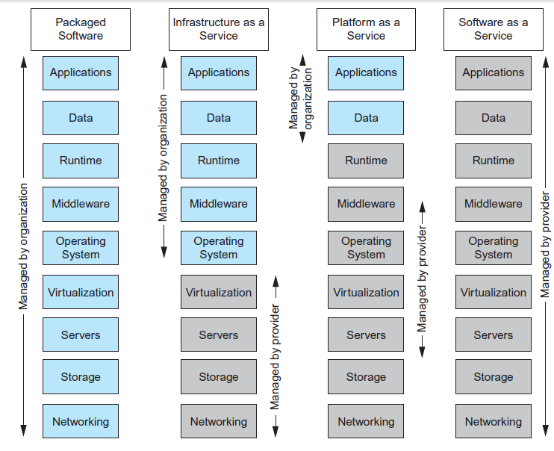
Cloud Computing – Comparison of Services Models
Notes:
Grey color : Cloud Service Provider Responsibility
Blue Color: Functionality assured by the customer/organization.

Slide 34
Cloud computing deployment models
Private cloud. The cloud infrastructure is provisioned for exclusive use by a single organization comprising multiple consumers (e.g., business units). It may be owned, managed, and operated by the organization, a third party, or some combination of them, and it may exist on or off premises.
Community cloud. The cloud infrastructure is provisioned for exclusive use by a specific community of consumers from organizations that have shared concerns (e.g., mission, security requirements, policy, and compliance considerations). It may be owned, managed, and operated by one or more of the organizations in the community, a third party, or some combination of them, and it may exist on or off premises.
Public cloud. The cloud infrastructure is provisioned for open use by the general public. It may be owned, managed, and operated by a business, academic, or government organization, or some combination of them. It exists on the premises of the cloud provider.
Hybrid cloud. The cloud infrastructure is a composition of two or more distinct cloud infrastructures (private, community, or public) that remain unique entities, but are bound together by standardized or proprietary technology that enables data and application portability (e.g., cloud bursting for load balancing between clouds).

Slide 35
Benefits of Cloud Computing (1 of 2)
Cost-Reduction: Avoid up-front capital expenditure.
Scalability/Agility: Organizations set up resources on an as-needs basis.
Improved Security: Providers can devote expertise & resources to security; not affordable by customer.
Improved Reliability: Providers can devote expertise & resources on reliability of systems; not affordable by customer.
Access to new technologies: Through use of provider’s systems, customers may access latest technology.

Slide 36
Benefits of Cloud Computing (2 of 2)
Faster development: Provider’s platforms can provide many of the core services to accelerate development cycle.
Large scale prototyping/load testing: Providers have the resources to enable this.
More flexible working practices: Staff can access files using mobile devices.
Increased competitiveness: Allows organizations to focus on their core competencies rather than their IT infrastructures.

Slide 37
Risks of Cloud Computing
Network Dependency: Power outages, bandwidth issues and service interruptions.
System Dependency: Customer’s dependency on availability and reliability of provider’s systems.
Cloud Provider Dependency: Provider could become insolvent or acquired by competitor, resulting in the service suddenly terminating.
Lack of control: Customers unable to deploy technical or organizational measures to safeguard the data. May result in reduced availability, integrity, confidentiality, intervenability and isolation.
Lack of information on processing transparency

Slide 38
Cloud computing benefits and risks
Benefits | Risks
Cost reduction Scalability/agility Improved security Access to new technologies Large-scale prototyping More flexible working practices Increased competitiveness | Network dependency System dependency Cloud provider dependency Lack of control over the data Lack of intervenability Lack of transparency

Slide 39
Cloud-Based Database Solutions (1 of 8)
As a type of Software as a Service (S a a S), cloud-based database solutions fall into two basic categories:
Data as a Service (D a a S) and
Database as a Service (D B a a S).
Key difference between the two options is mainly how the data is managed.

Slide 40
Cloud-Based Database Solutions (2 of 8)
D B a a S
Offers full database functionality to application developers.
Provides a management layer that provides continuous monitoring and configuring of the database to optimized scaling, high availability, multi-tenancy (that is, serving multiple client organizations), and effective resource allocation in the cloud, thereby sparing the developer from ongoing database administration tasks.

Slide 41
Cloud-Based Database Solutions (3 of 8)
D a a S:
Services enables data definition in the cloud and subsequently querying.
Does not implement typical D B M S interfaces (e.g. S Q L) but instead data is accessed via common A P I s.
Enables organization with valuable data to offer access to others. Examples Urban Mapping (geography data service), Xignite (financial data service) and Hoovers (business data service.)

Slide 42
Cloud-Based Database Solutions (4 of 8)
Separate database servers
You pay more!

Slide 43
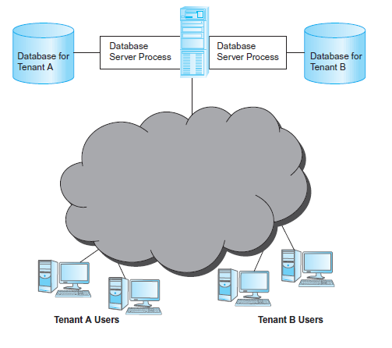
Cloud-Based Database Solutions (5 of 8)
Multi-tenant cloud database-shared server, separate database server process architecture.
Each tenant has its own memory and disk resources and is unable to share unused resources with other virtual environments, and this is an issue!
Performance issues!
Security is not an issue!

Slide 44
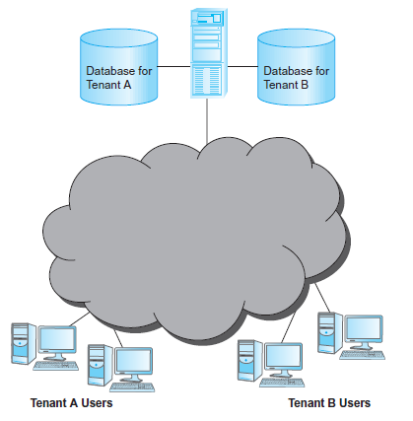
Cloud-Based Database Solutions (6 of 8)
Multi-tenant cloud database-shared D B M S server, separate databases.
Can share unused resources between tenants to support better utilization of resources!

Slide 45
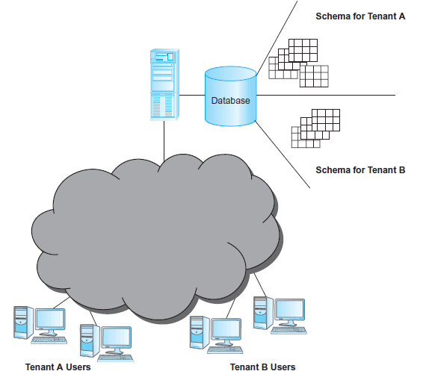
Cloud-Based Database Solutions (7 of 8)
Multi-tenant cloud database–shared database, separate schema architecture.
The DBMS must have a permission structure to ensure that users only have access to the data schema that they are allowed to access.

Slide 46
Cloud-Based Database Solutions (8 of 8)
Shared database, shared schema
Each database table must have a column used to identify the owner of the row!
Any application accessing this row must refer to this column in every query to ensure that one tenant is not able to see another tenant’s data!
Low costs for hardware and backup!
High security risks!

Slide 47
Components of a DBMS

Slide 48
Components of a D B M S (1 of 5)
A D B M S is partitioned into several software components (or modules), each of which is assigned a specific operation. As stated previously, some of the functions of the D B M S are supported by the underlying operating system.
The D B M S interfaces with other software components, such as user queries and access methods (file management techniques for storing and retrieving data records).

Slide 49
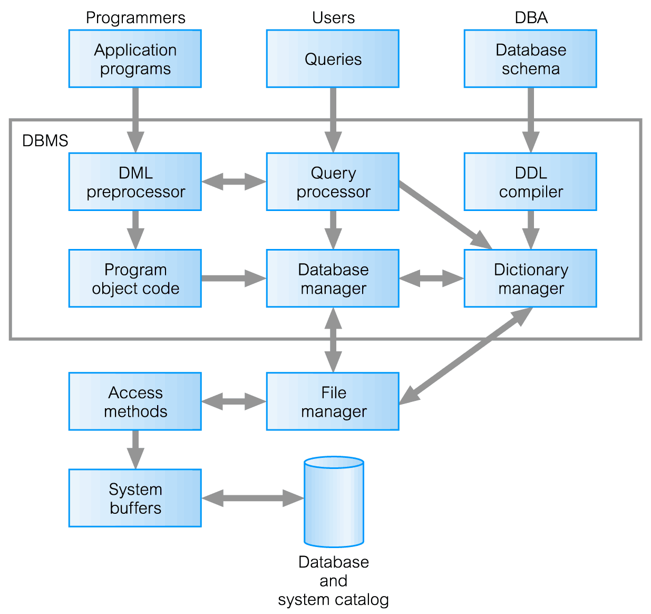
Components of a D B M S (2 of 5)

Slide 50
Components of a D B M S (3 of 5)
Query processor is a major DBMS component that transforms queries into a series of low-level instructions directed to the database manager.
Database manager (DM) interfaces with user-submitted application programs and queries.
The DM examines the external and conceptual schemas to determine what conceptual records are required to satisfy the request.
The DM then places a call to the file manager to perform the request.

Slide 51
Components of a D B M S (4 of 5)
File manager manipulates the underlying storage files and manages the allocation of storage space on disk. It establishes and maintains the list of structures and indexes defined in the internal schema.
DML preprocessor converts DML statements embedded in an application program into standard function calls in the host language. The DML preprocessor must interact with the query processor to generate the appropriate code.

Slide 52
Components of a D B M S (5 of 5)
DDL compiler converts DDL statements into a set of tables containing metadata. These tables are then stored in the system catalog while control information is stored in data file headers.
Dictionary/Catalog manager manages access to and maintains the system catalog. The system catalog is accessed by most DBMS components.

Slide 53
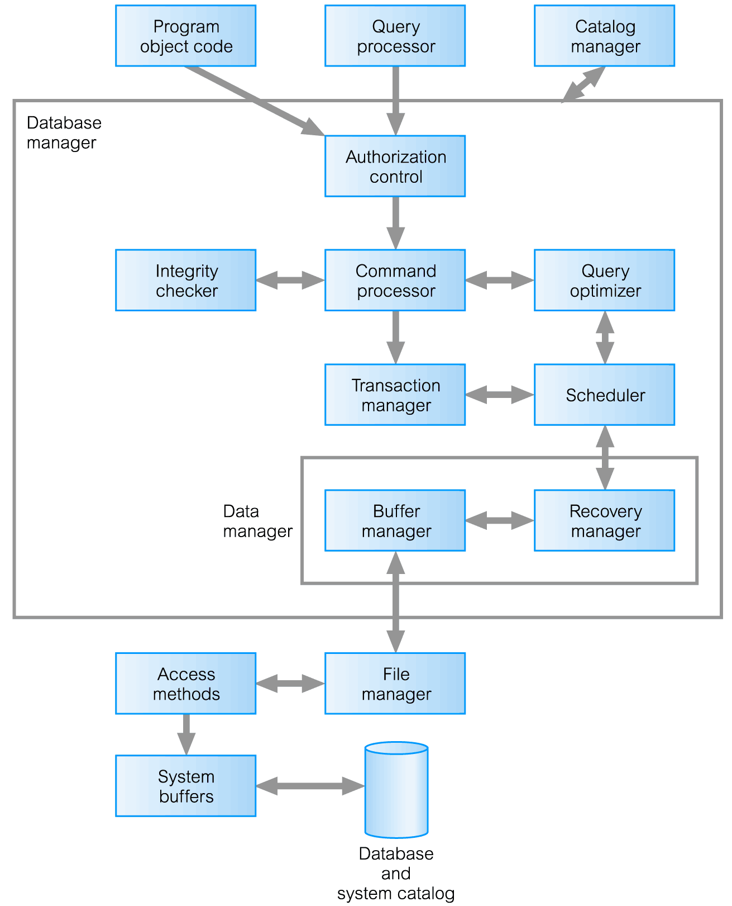
Components of Database Manager (D M) (1 of 4)

Slide 54
Components of Database Manager (DM) (2 of 4)
Authorization control to confirm whether the user has the necessary permission to carry out the required operation.
Command processor on confirmation of user authority, control is passed to the command processor.
Integrity checker ensures that requested operation satisfies all necessary integrity constraints (e.g. key constraints) for an operation that changes the database.

Slide 55
Components of Database Manager (DM) (3 of 4)
Query optimizer determines an optimal strategy for the query execution.
Transaction manager performs the required processing of operations that it receives from transactions.
Scheduler ensures that concurrent operations on the database proceed without conflicting with one another. It controls the relative order in which transaction operations are executed.

Slide 56
Components of Database Manager (DM) (4 of 4)
Recovery manager ensures that the database remains in a consistent state in the presence of failures. It is responsible for transaction commit and abort.
Buffer manager responsible for the transfer of data between main memory and secondary storage, such as disk and tape.
The recovery manager and the buffer manager also known as (aka) the data manager. The buffer manager aka the cache manager.

Slide 57
Summary
Overview of several multi-user database architectures that differed in the way application programs, DBMS, and database are located.
The architectures had pros and cons with regard to performance, security, load balancing, and modularity.
Cloud computing offers a wide range of multi-tenant architectures by combining shared and dedicated IT resources for multi-user database environments.
The logical and physical distributed nature of organizations required using distributed DBMSs.
Distributed DBMS differs from distributed processing.

Slide 58
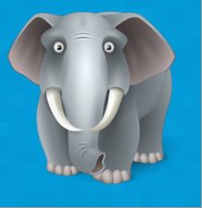
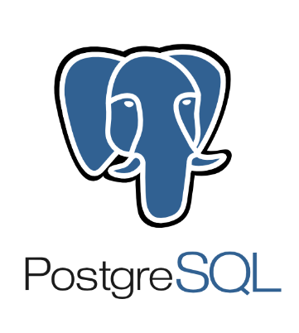
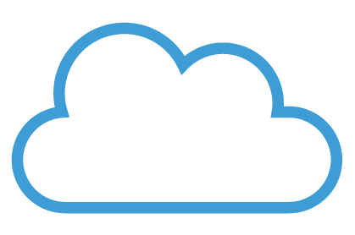
Summary
Tutorial on Cloud-based solutions for databases
ElephantSQL

